Slide 1
Cyber bullying Detection on Social Networks Using Machine Learning Approaches
MOHAMMED LIJAS C
MES20MCA-2028
PRODUCT OWNER: MR VASUDEVAN T.V

Slide 2
TABLE OF CONTENTS
Introduction
Modules
Data Flow Diagram
Developing Environment
Product Backlog
User Stories
Project Plan
Sprint Plans
Sprint Actual

Slide 3
INTRODUCTION
Cyberbullying can be defined as aggressive, intentional actions performed by an individual or a group of people via digital communication methods such as sending messages and posting comments against a victim.
Different from traditional bullying that usually occurs at school during face-to-face communication, cyber bullying on social media can take place anywhere at any time.
Cyberbullying frequently leads to serious mental and physical distress, particularly for women and children, and even sometimes force them to attempt suicide.
The purpose of this research is to design and develop an effective technique to detect online abusive and bullying messages by merging natural language processing and machine learning. Two distinct features,namely Bag-of - Words and term frequency-inverse text frequency (TF-IDF), are used to analyse the accuracy level of four distinct machine learning algorithms.
In this paper, we proposed a novel friend recommendation framework (FRF) basedon the behavior of users on particular SNS's. The proposed method is consisted of the following stages: measuring the frequency of the activities done by the users and updating the dataset according to the activities, applying FP- Growth algorithm to classify the user behavior with some criteria, then apply multilayer thresholding for friend recommendation.
In propsed system, we suggest a cyberbullying detection model based on machine learning that can detect whether a text relates to cyberbullying or not.or performance analysis, we use two different feature vectors BoW and TF-IDF.
The results indicate that TF-IDF feature provides better accuracy than BoW. Users behaviour could be defined inseveral approaches like association rules in perspective of mining, complex graph activities, sequence mining etc.Suppose for two different user we have same behaviour we can recommend them each other.

Slide 4
MODULES
ADMIN
1.View user
2.Add bullying words
3.Add good words
4.View bullying words
5.View good words
6.View report

Slide 5
USER
1.Registration
2.Add post
3.View my post
4.Chat
5.Add bullying words
6.Add friend request
7.View friend request
8.View recommendation

Slide 6
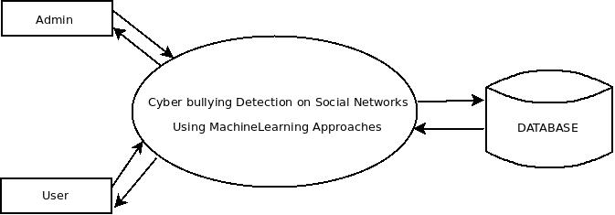
DATA FLOW DIAGRAM
LEVEL 0

Slide 7
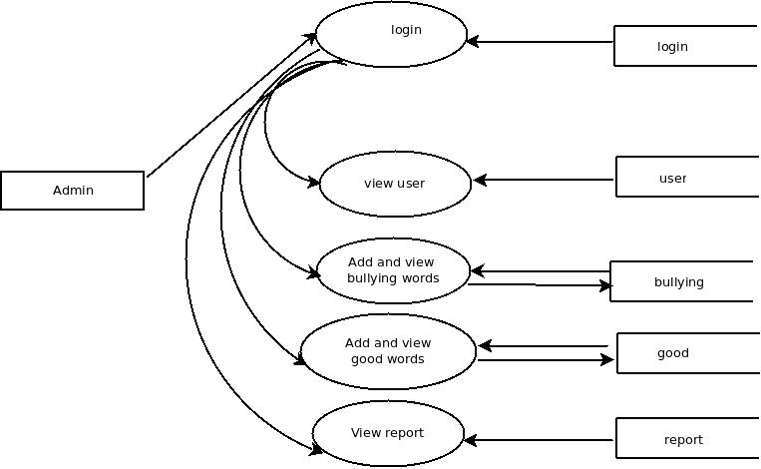
LEVEL 1.1

Slide 8
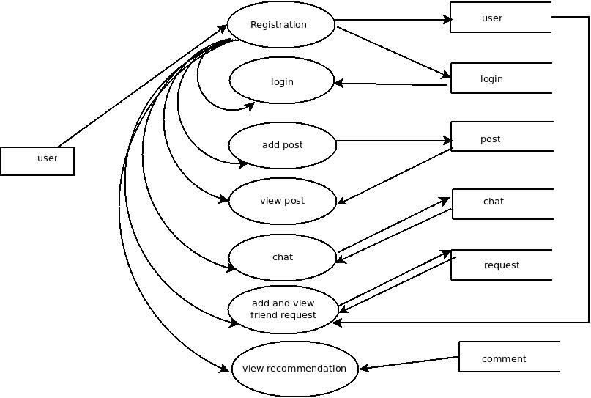
LEVEL 1.2

Slide 9
DEVELOPING ENVIRONMENT
Hardware Requirements
Processor - Intel x86
Speed - 1.1 GHz
RAM - 4 GB (min)
Hard Disk - 50 GB
Software Requirements
Operating System - Windows 7 or Above , Linux
Frontend – HTML,CSS,JavaScript
Backend – Python ,MySQL
Platform used - PyCharm, MySQL workbench
Web Browser - Google Chrome, Fire fox, Microsoft Edge
Frame work - Flask

Slide 10
PRODUCT BACKLOG
User Story ID | Priority <High/Medium/Low> | Size (Hours) | Sprint <#> | Status <Planned/In progress/Completed> | Release Date | Release Goal
1 | Medium | 2 | 1 | Completed | 08/01/2022 | Table design
2 | High | 3 |  | Completed | 08/01/2022 | Form design
3 | High | 5 |  | Completed | 08/01/2022 | Basic coding
4 | High | 5 | 2 | Planned |  | Creation of data set
5 | Medium | 5 |  | Planned |  | Prediction
6 | High | 5 | 3 | Planned |  | Filtering
7 | high | 5 |  | Planned |  | Machine learning
8 | Medium | 5 | 4 | Planned |  | Testing data
9 | High | 5 |  | Planned |  | Output generation
Notes:
<number>

Slide 11
USER STORIES
UserStoryID | As a <type of user> | I want to | So that I can
1 | Admin | login | login successful with correct username and password
2 | Admin | View users | View all user details
3 | Admin | Add bullying words | Add bullying words
4
5
6
7
8

Slide 12
PROJECT PLAN
User Story ID | Task Name | Start Date | End Date | Days | Status
1 | Sprint 1 | 26/12/2021 | 28/12/2021 | 2 | Completed
2 |  | 29/12/2021 | 31/12/2021 | 3 | Completed
3 |  | 03/1/2022 | 08/01/2022 | 5 | Completed
4 | Sprint 2 | 09/01/2022 | 16/01/2022 | 8 | Planned
5 |  | 18/01/2022 | 22/01/2022 | 5 | Planned
6 | Sprint 3 | 23/01/2022 | 27/01/2022 | 5 | Planned
7 |  | 30/01/2022 | 05/02/2022 | 7 | Planned
8 | Sprint 4 | 06/02/2022 | 10/01/2022 | 5 | Planned
9 |  | 16/02/2022 | 19/02/2022 | 4 | Planned

Slide 13
SPRINT BACKLOG PLAN
Backlog Item | Status & completion date | Original estimate in hours | Day1 | Day2 | Day3 | Day4 | Day5 | Day6 | Day7 | Day8 | Day9 | Day10 | Day11 | Day12 | Day13 | Day14
User story #1,#2,#3,#4 |  | hrs | hrs | hrs | hrs | hrs | hrs | hrs | hrs | hrs | hrs | hrs | hrs | hrs | hrs | hrs
Table design | 28/12/2021 | 2 | 1 | 1 | 0 | 0 | 0 | 0 | 0 | 0 | 0 | 0 | 0 | 0 | 0 | 0
Form design | 31/12/2021 | 3 | 0 | 0 | 0 | 1 | 1 | 1 | 0 | 0 | 0 | 0 | 0 | 0 | 0 | 0
Basic Coding | 08/01/2021 | 5 | 0 | 0 | 0 | 0 | 0 | 0 | 0 | 0 | 0 | 1 | 1 | 1 | 1 | 1
User story #5,#6,#7,#8
Creation of data set | 16/01/2022 | 5 | 1 | 1 | 0 | 1 | 0 | 1 | 0 | 1 | 0 | 0 | 0 | 0 | 0 | 0
Prediction | 22/01/2022 | 5 | 0 | 0 | 0 | 0 | 0 | 0 | 0 | 0 | 0 | 1 | 1 | 1 | 1 | 1
Filtering | 27/01/2022 | 5 | 1 | 1 | 1 | 1 | 1 | 0 | 0 | 0 | 0 | 0 | 0 | 0 | 0 | 0
Machine learning | 05/02/2022 | 5 | 0 | 0 | 0 | 0 | 0 | 0 | 0 | 1 | 0 | 1 | 1 | 1 | 0 | 1
Testing data | 10/01/2022 | 5 | 1 | 1 | 1 | 1 | 1 | 0 | 0 | 0 | 0 | 0 | 0 | 0 | 0 | 0
User story #9
Output generation | 20/02/2022 | 5 | 0 | 0 | 0 | 0 | 0 | 0 | 0 | 0 | 0 | 2 | 1 | 1 | 1 | 1
Total |  | 40 | 4 | 4 | 2 | 4 | 3 | 2 | 0 | 2 | 0 | 5 | 4 | 4 | 3 | 4

Slide 14
SPRINT ACTUAL
Backlog Item | Status & completion date | Original estimate in hours | Day1 | Day2 | Day3 | Day4 | Day5 | Day6 | Day7 | Day8 | Day9 | Day10 | Day11 | Day12 | Day13 | Day14
User story #1,#2,#3,#4 |  | hrs | hrs | hrs | hrs | hrs | hrs | hrs | hrs | hrs | hrs | hrs | hrs | hrs | hrs | hrs
Table design | 28/12/2021 | 3 | 1 | 1 | 0 | 0 | 0 | 0 | 0 | 0 | 0 | 0 | 0 | 0 | 0 | 0
Form design | 31/12/2021 | 2 | 0 | 0 | 0 | 1 | 1 | 1 | 0 | 0 | 0 | 0 | 0 | 0 | 0 | 0
Basic Coding | 08/01/2021 | 5 | 0 | 0 | 0 | 0 | 0 | 0 | 0 | 0 | 0 | 1 | 1 | 1 | 1 | 1
User story #5,#6,#7,#8
Creation of data set
prediction
Filtering
Testing data
User story #9
Output generation
Total |  | 10 | 1 | 1 | 0 | 1 | 1 | 1 | 0 | 0 | 0 | 1 | 1 | 1 | 1 | 1

Slide 15
THANK YOU

